Slide 1
Social Media Info for parents and their kids
Jessica Morman
Troup County Schools
Assistive Technology Specialist
3-24-15

Slide 2
What is social media?
Social media is digital content and interaction that is created by and between people.
Sam Decker – Mass Relevance

Slide 3
Computer = websites
www.
Smartphone/tablet= APPS

Slide 4
What do you use?
www.socrative.com
Enter my room: jmorman

Slide 5
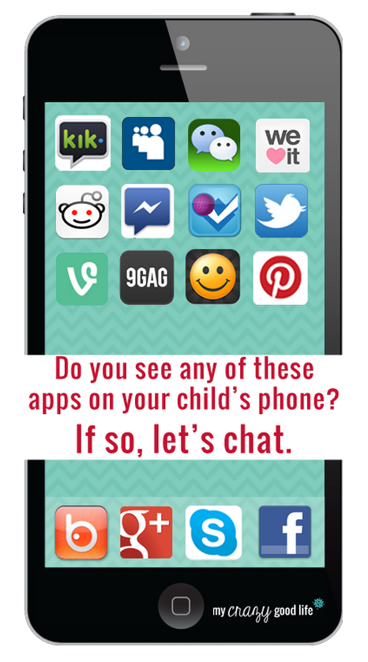
Notes:
Look over handout about the specific apps

Slide 6
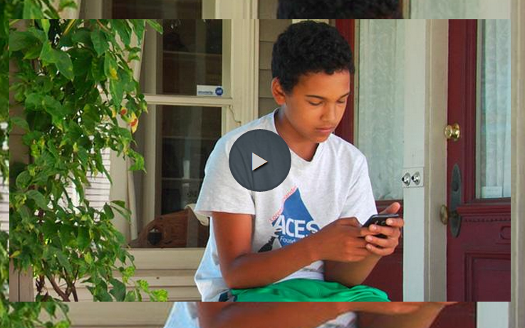
Social Media Trends

Slide 7
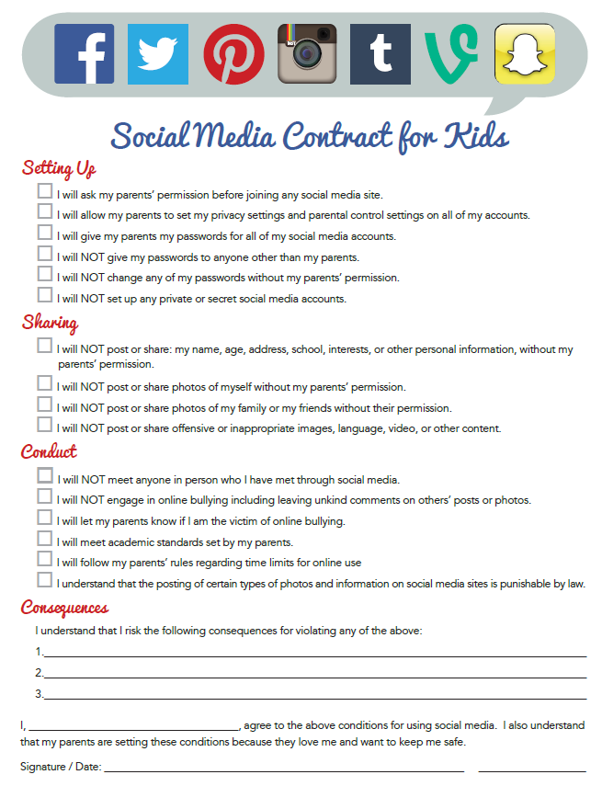

Slide 9
“How to” picture guides
*Also check out the help tabs or tutorial videos most sites offer!

Slide 10
The “lingo”

Slide 11
Netiquette ☺

Slide 12
Resources!
Social Networking for Teens
Privacy and Internet Safety
Staying Safe online for Teens
Digital Citizenship
Cyberbullying
Appropriate posts
Digital Footprint
Notes:
Go to video on offline consequences on NSTeens

Slide 13
Questions/Contact
Jessica Morman
mormanj@troup.org
http://tcssat.weebly.com

